Slide 1
Naan Mudhalvan Project Adaptive Mail: A Flexible Email Client App
Team Members: Arthi R [7155220104006] Mahesh K [7155220104032] Mathuranathan R [7155220104033] Sanjeeve Sankar S [7155220104047]

Slide 2
DESCRIPTION
The Adaptive Mail App is a sample project designed to demonstrate the capabilities of the Android Jetpack Compose UI toolkit in building a fluid, responsive, and conversational user interface. The app mimics a messaging platform, enabling users to engage in a simulated chat environment where they can send, receive, and view message history.
This project serves as an example of effective Compose UI implementation, showcasing key Compose features such as flexible layouts, state management, and dynamic UI updates in response to user interactions. It also incorporates data management techniques to handle message history and maintain a smooth, uninterrupted user experience.

Slide 3
The key features of this project include:
User Registration and Login:
New users can register an account within the app.
Registered users can securely log in to access personalized email functionality.
Main Interface:
After logging in, users are directed to the main page, which provides a clean, Compose-based UI to navigate the app’s features.
The interface is designed with Compose's declarative UI elements for a responsive and visually appealing experience.
View Email History:
Users can view a list of previously sent emails.
Each email entry displays essential information like the subject line and date sent, making it easy to navigate through past correspondence.
Compose and Send Emails:
Users can compose a new email by providing a subject and body text.
The Compose UI simplifies the input process, making it seamless to draft and send messages within the app.
Efficient Data Management and State Handling:
The app ensures smooth transitions and updates by managing data effectively, maintaining email history and user input across the session.

Slide 4
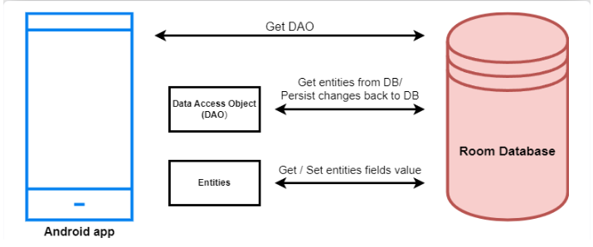
Architecture

Slide 5
Code Implementation
main_activity.kt
package com.example.emailapplication
import android.content.Context
import android.content.Intent
import android.os.Bundle
import androidx.activity.ComponentActivity
import androidx.activity.compose.setContent
import androidx.compose.foundation.Image
import androidx.compose.foundation.background
import androidx.compose.foundation.layout.*
import androidx.compose.material.*
import androidx.compose.runtime.Composable
import androidx.compose.ui.Alignment
import androidx.compose.ui.Modifier
import androidx.compose.ui.graphics.Color
import androidx.compose.ui.layout.ContentScale
import androidx.compose.ui.res.painterResource

Slide 6
Code Implementation
import androidx.compose.ui.text.font.FontWeight
import androidx.compose.ui.tooling.preview.Preview
import androidx.compose.ui.unit.dp
import androidx.compose.ui.unit.sp
import androidx.core.content.ContextCompat
import androidx.core.content.ContextCompat.startActivity
import com.example.emailapplication.ui.theme.EmailApplicationTheme
class MainActivity : ComponentActivity() {
override fun onCreate(savedInstanceState: Bundle?) {
super.onCreate(savedInstanceState)
setContent {
// A surface container using the 'background' color from the theme
Surface(
modifier = Modifier.fillMaxSize().background(Color.White),
) {
Email(this)
} } }
}

Slide 7
Code Implementation
@Composable
fun Email(context: Context) {
Text(
text = "Home Screen",
modifier = Modifier.padding(top = 74.dp, start = 100.dp, bottom = 24.dp),
color = Color.Black,
fontWeight = FontWeight.Bold,
fontSize = 32.sp
)
Column(
horizontalAlignment = Alignment.CenterHorizontally,
verticalArrangement = Arrangement.Center
) {
Image(
painterResource(id = R.drawable.home_screen), contentDescription = ""
)

Slide 8
Code Implementation
Button(onClick = {
context.startActivity(
Intent(
context,
SendMailActivity::class.java
)
)
},
colors = ButtonDefaults.buttonColors(backgroundColor = Color(0xFFadbef4))
) {
Text(
text = "Send Email",
modifier = Modifier.padding(10.dp),
color = Color.Black,
fontSize = 15.sp
)
}

Slide 9
Code Implementation
Spacer(modifier = Modifier.height(20.dp))
Button(onClick = {
context.startActivity(
Intent(
context,
ViewMailActivity::class.java
) )
},
colors = ButtonDefaults.buttonColors(backgroundColor = Color(0xFFadbef4))
) {
Text(
text = "View Emails",
modifier = Modifier.padding(10.dp),
color = Color.Black,
fontSize = 15.sp
)
} }
}

Slide 10
Code Implementation
LoginActivity.kt
package com.example.emailapplication
import android.content.Context
import android.content.Intent
import android.os.Bundle
import androidx.activity.ComponentActivity
import androidx.activity.compose.setContent
import androidx.compose.foundation.Image
import androidx.compose.foundation.background
import androidx.compose.foundation.layout.*
import androidx.compose.material.*
import androidx.compose.runtime.*
import androidx.compose.ui.Alignment
import androidx.compose.ui.Modifier
import androidx.compose.ui.graphics.Color
import androidx.compose.ui.layout.ContentScale
import androidx.compose.ui.res.painterResource

Slide 11
Code Implementation
import androidx.compose.ui.text.input.PasswordVisualTransformation
import androidx.compose.ui.tooling.preview.Preview
import androidx.compose.ui.unit.dp
import androidx.compose.ui.unit.sp
import androidx.core.content.ContextCompat
import com.example.emailapplication.ui.theme.EmailApplicationTheme
class LoginActivity : ComponentActivity() {
private lateinit var databaseHelper: UserDatabaseHelper
override fun onCreate(savedInstanceState: Bundle?) {
super.onCreate(savedInstanceState)
databaseHelper = UserDatabaseHelper(this)
setContent {
LoginScreen(this, databaseHelper)
}
}
}

Slide 12
Code Implementation
@Composable
fun LoginScreen(context: Context, databaseHelper: UserDatabaseHelper) {
var username by remember { mutableStateOf("") }
var password by remember { mutableStateOf("") }
var error by remember { mutableStateOf("") }
Column(
modifier = Modifier.fillMaxSize().background(Color.White),
horizontalAlignment = Alignment.CenterHorizontally,
verticalArrangement = Arrangement.Center
) {
Image(
painterResource(id = R.drawable.email_login), contentDescription = ""
)

Slide 13
Code Implementation
Text(
fontSize = 36.sp,
fontWeight = FontWeight.ExtraBold,
fontFamily = FontFamily.Cursive,
text = "Login"
)
Spacer(modifier = Modifier.height(10.dp))
TextField(
value = username,
onValueChange = { username = it },
label = { Text("Username") },
modifier = Modifier.padding(10.dp)
.width(280.dp)
)

Slide 14
Code Implementation
TextField(
value = password,
onValueChange = { password = it },
label = { Text("Password") },
visualTransformation = PasswordVisualTransformation(),
modifier = Modifier.padding(10.dp)
.width(280.dp)
)
if (error.isNotEmpty()) {
Text(
text = error,
color = MaterialTheme.colors.error,
modifier = Modifier.padding(vertical = 16.dp)
)
}
}

Slide 15
Code Implementation
Button(
onClick = {
if (username.isNotEmpty() && password.isNotEmpty()) {
val user = databaseHelper.getUserByUsername(username)
if (user != null && user.password == password) {
error = "Successfully log in"
context.startActivity(
Intent(
context,
MainActivity::class.java
)
)
//onLoginSuccess()
}
} else {
error = "Please fill all fields"
}
},

Slide 16
Code Implementation
colors = ButtonDefaults.buttonColors(backgroundColor = Color(0xFFd3e5ef)),
modifier = Modifier.padding(top = 16.dp)
) {
Text(text = "Login")
}
Row {
TextButton(onClick = {context.startActivity(
Intent(
context,
RegisterActivity::class.java
)
)}
)
{ Text(color = Color(0xFF31539a),text = "Sign up") }
TextButton(onClick = {
})

Slide 17
Code Implementation
{
Spacer(modifier = Modifier.width(60.dp))
Text(color = Color(0xFF31539a),text = "Forget password?")
}
}
}
}
private fun startMainPage(context: Context) {
val intent = Intent(context, MainActivity::class.java)
ContextCompat.startActivity(context, intent, null)

Slide 18
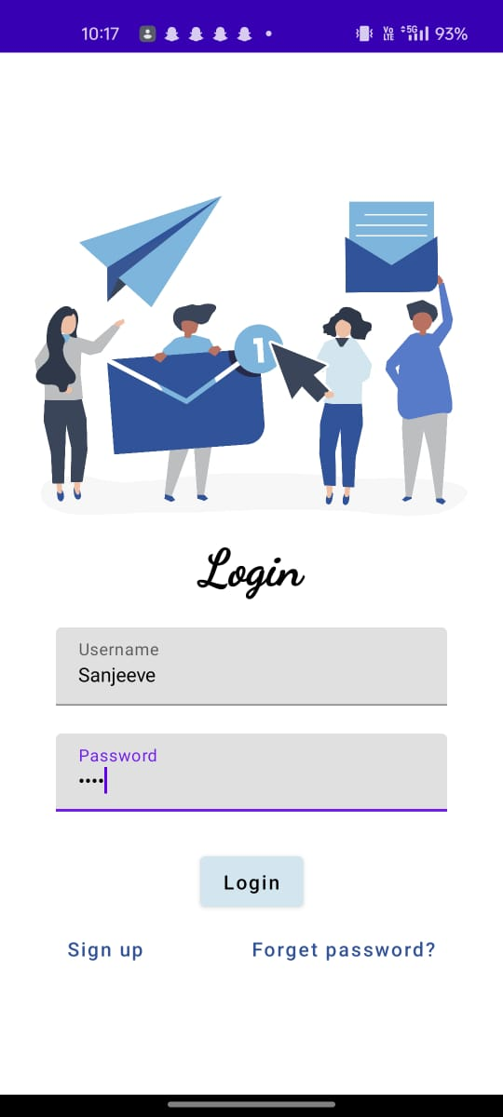
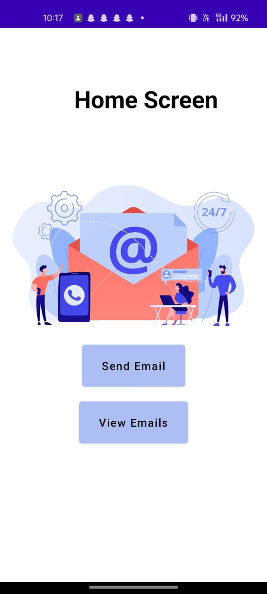
OUPUT

Slide 19
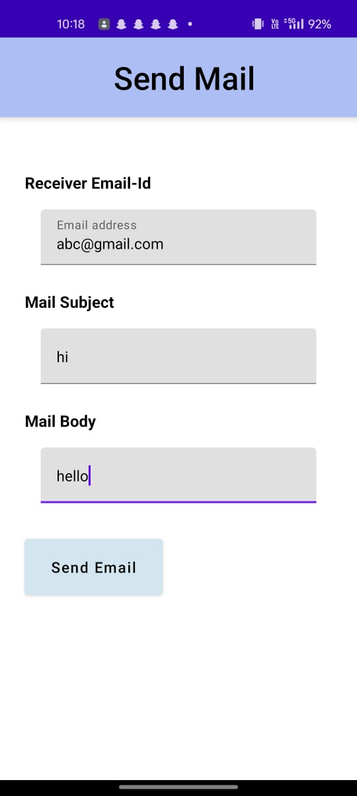
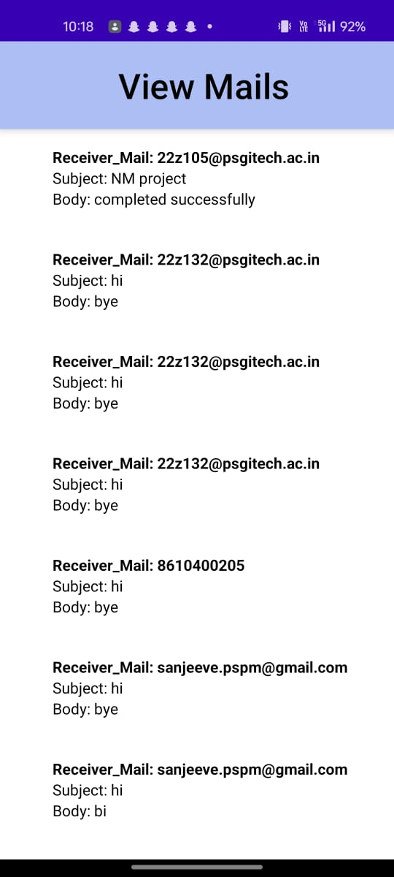
OUPUT

